Slide 1

Revitalizing Local Journalism
with AI-Assisted Writing:
a Human-in-the-loop Approach
Haoruo Peng News Break
April 14, 2021
The 1st International Workshop on News Recommendation and Intelligence
The Web Conference 2021

Slide 2



Local News

Slide 3
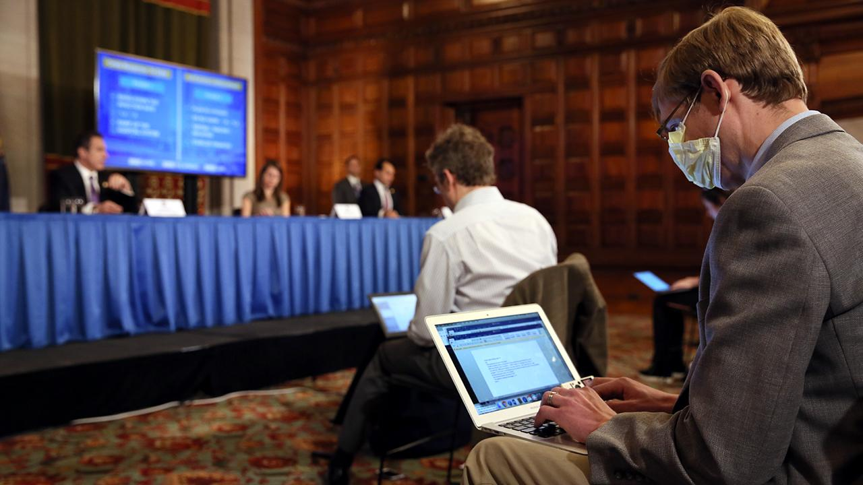
Why Local News Matters?
A prime source of credible and comprehensive news and information
Huge impact to democracy, the way of life in rural areas and the society in general
Effects to local community trust building
https://nysba.org/why-local-news-matters-and-what-we-can-do-to-save-it/
Notes:
70% Covid Election We do believe this is true for any country

Slide 4
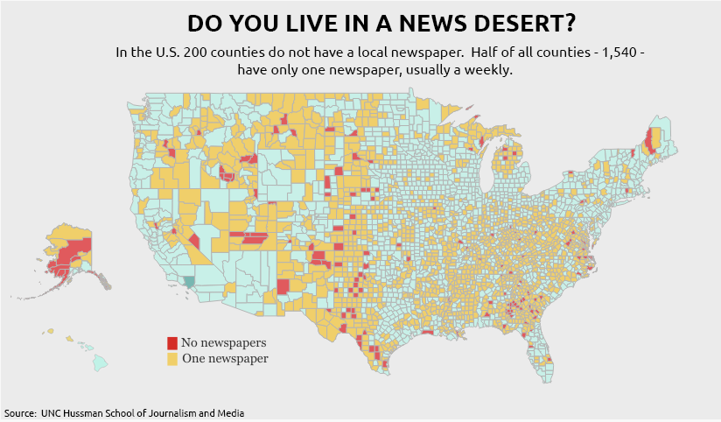
Struggling Local Journalism
Notes:
According to a study Local journalists get layed off Many reasons

Slide 5

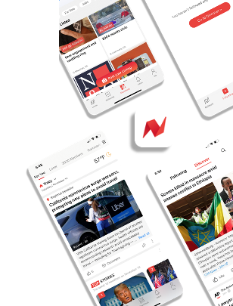
Our Mission at News Break
Revitalizing local journalism by directly empowering local journalists
Support more automation via AI-assisted writing which directly address journalists’ pain points
The targeted content source for this talk
PGC (Publisher Generated Content)
MGC (Machine Generated Content)
UGC (User Generated Content)
Notes:
Instead of replacing Acknowledge other players in the field

Slide 6
Overview
Part I: Study on how a local journalist create news pieces
Part II: AI-assisted writing in action at News Break
Part III: A human-in-the-loop approach
Part IV: Conclusions and open problems

Slide 7
Study on How a Local Journalist Create News Pieces

Slide 8
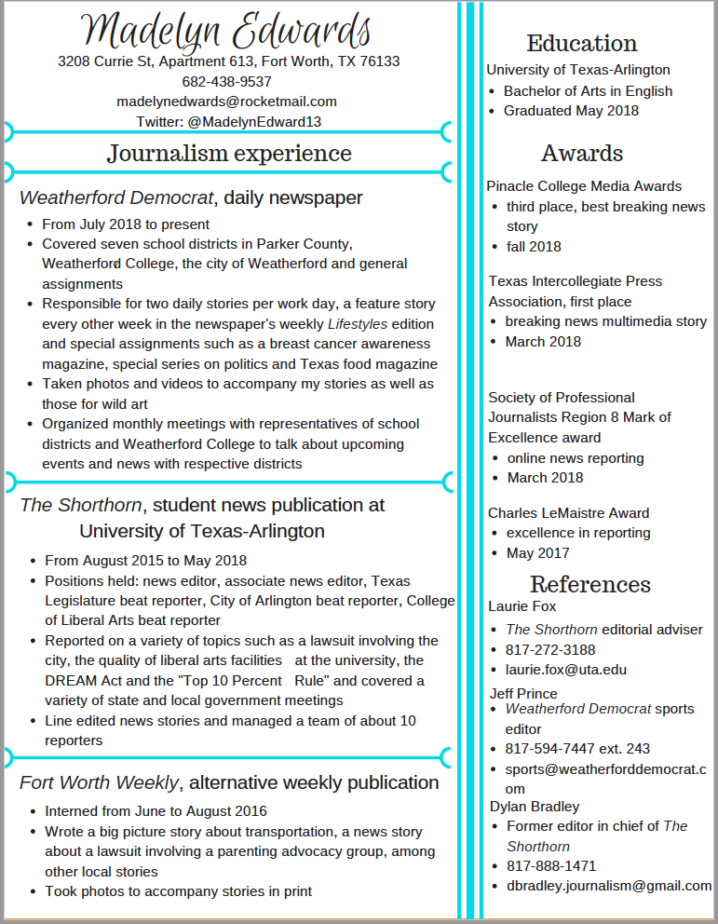
Local Journalist Team at News Break
23 full-time contracted local journalists + 3 part-time college interns from journalism schools
Profile Info
Gender Diversity
40% female & 60% male
Locality Diversity
Locate across 10+ cities / regions across U.S.
Majority have been living in their current city / region for 5+ years
Expertise Qualification
All have bachelor degrees from journalism schools
An average of 3-year experience in local journalism

Slide 9
User Research for Local Journalists
Face-to-face interviews (conducted remotely) consisting of 20+ questions
Editorial Experience
How do you choose a news topic to write about?
How do you find relevant background info?
How do you carry out the editing process?
CMS Experience
What CMS tools are you most familiar with?
What are your main complaints about the existing CMS system?
Metric Awareness
How do you evaluate the performance of your articles?
Screen recording of the whole process for a sample news piece creation from local journalists

Slide 10
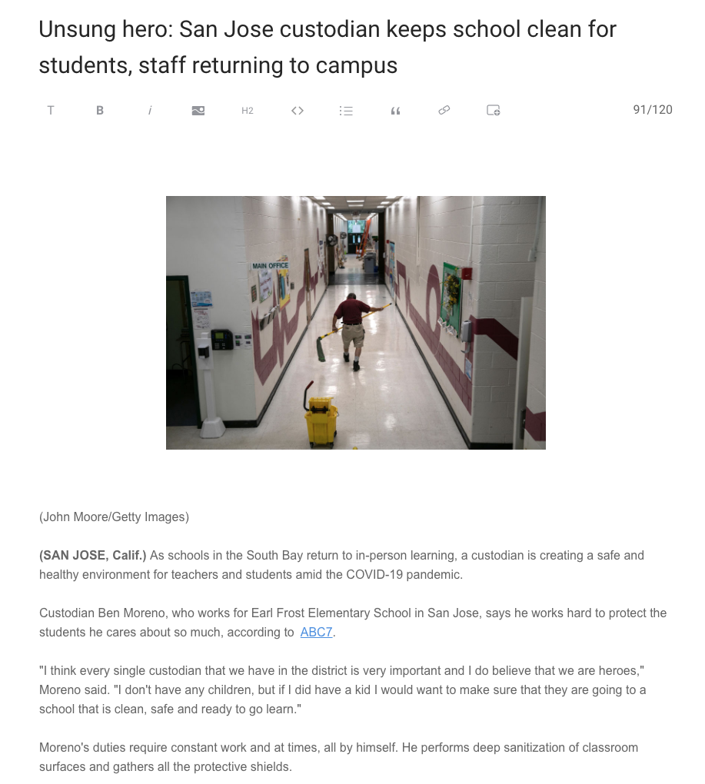
Our Findings
An Over-Simplified Process of Content Creation for Local Journalists
Step 1: Decide on the newsworthy topic to write
Pain Point 1 - Keep track of all local happenings
Imperfect Existing Solutions - Tweetdeck, AP Calendar ...
Pain Point 2 - Choose between different topics
Imperfect Existing Solutions - Human judgement based on experience / Newswhip, Samdesk …
Step 2: Gather related info on the news topic
Pain Point 1 - Keep track of the related local happenings
Pain Point 3 - Translate interview notes into presentable content
Step 3: The creative process of writing out the news piece
Step 4: Enrich the created content with good titles and imagery
Pain Point 4 - Come up with intriguing titles
Pain Point 5 - Find appropriate images from licensed image databases

Slide 11
AI-assisted Writing in Action at News Break

Slide 12
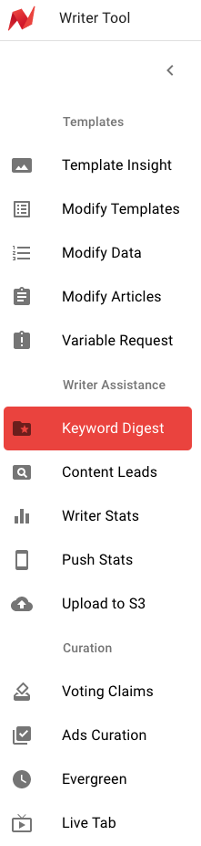
AI-assisted Writing
Our Definition
Technologies / Tools that can help local journalists improve the efficiency of the creative process of producing content
Suite of Tools (web-based) that are developed at News Break
Template Creation Tools
Writer Assistance Tools
Writer Curation Tools

Slide 13
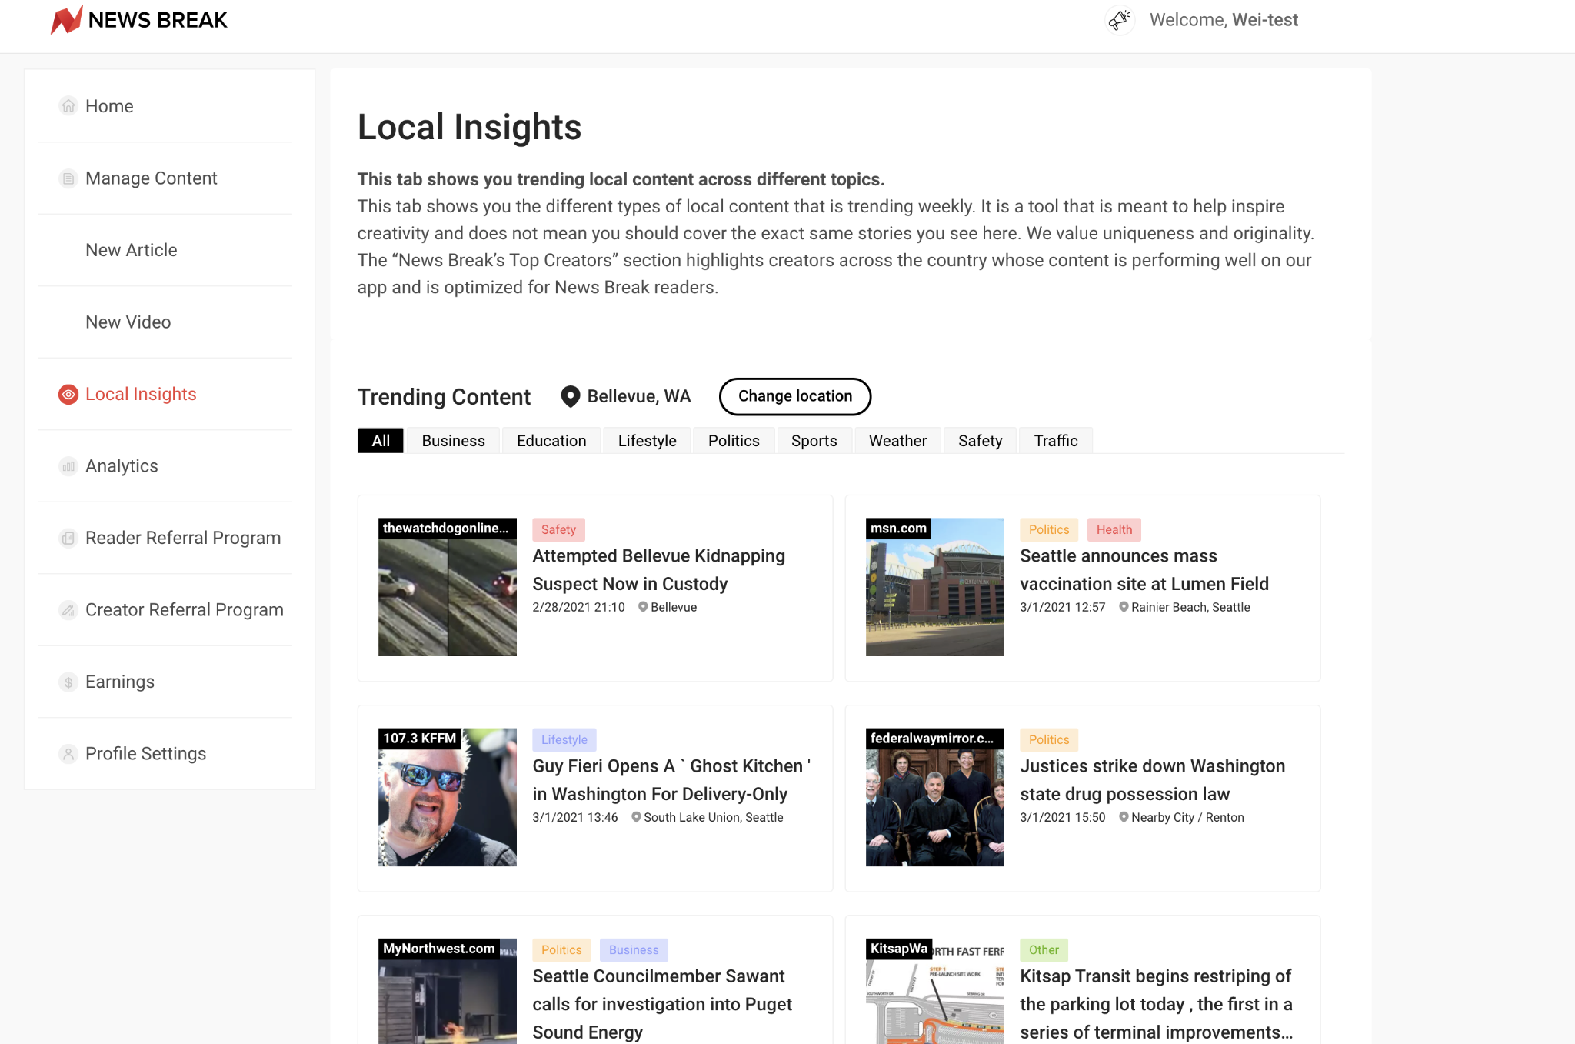
Local Content Leads Generation
Provide trending local news topics as leads
Address Pain Point 1 & 2
Keep track of local happenings
Choose between different topics
Technical Workflow
NLU Modules
Geo-tagging (entity linking)
Text Classification
News Clustering
Engagement Prediction
Summarization

Slide 14
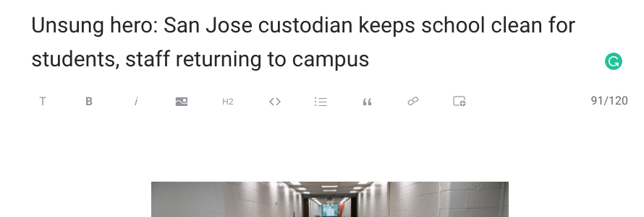
Title Rewriting
Provide alternative title suggestions
Address Pain Point 4
Come up with intriguing titles
Technical Workflow
Simple Motivation
Learn from the best
Modeling
Transformer-based sequence-to-sequence model
Data
Cold start data from push notification re-writes + PPDB
Active learning from writer choices with engagement verification

Slide 15
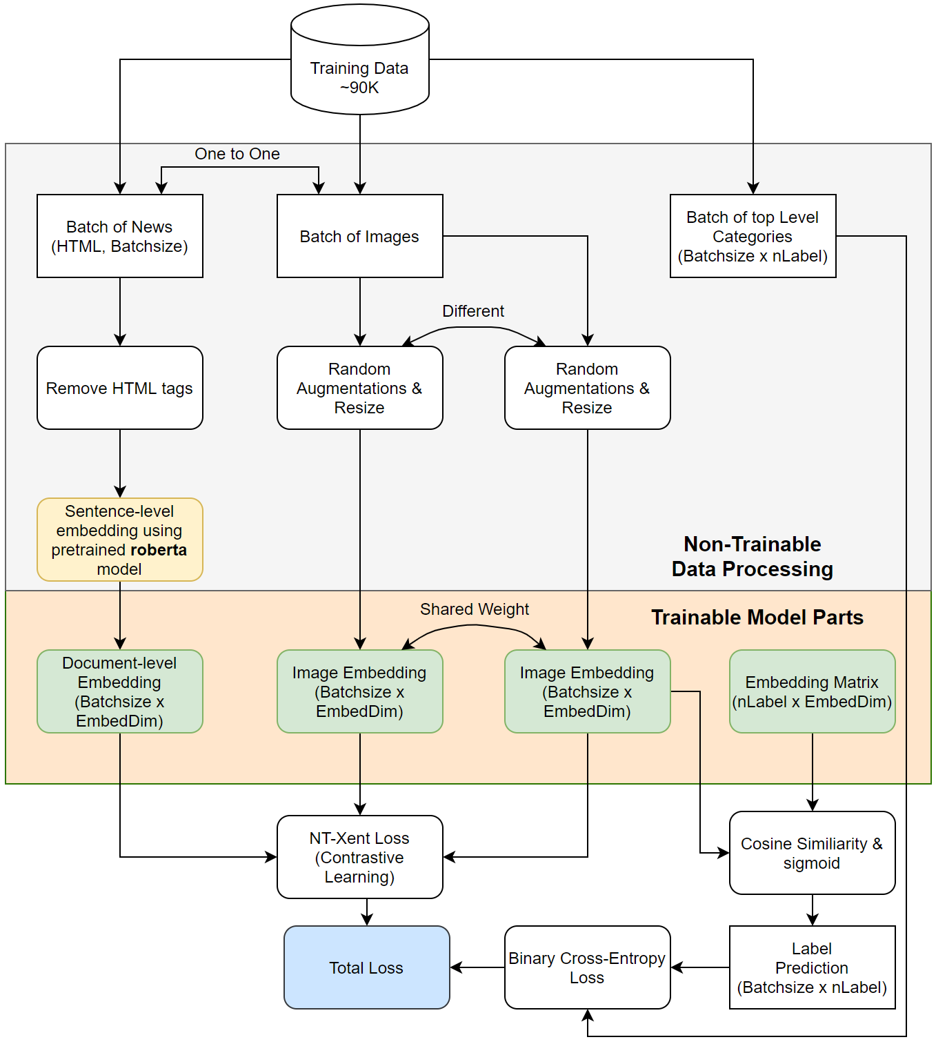
Image Auto Pairing
Provide image choices based on article text
Address Pain Point 5
Find appropriate images from licensed image databases
Technical Workflow
Modeling
Two-tower model with image and text embeddings + Multi-task training for image categories
Data
Cold start data from existing articles + random negative sampling
Active learning from writer choices

Slide 16
A Human-in-the-loop Approach
Notes:
Tool is nothing without a workflow

Slide 17
Editorial Process
Crucial for content quality control
Content Guidelines: https://creators.newsbreak.com/creator-content-requirements
Content Policies: https://creators.newsbreak.com/creator-content-policy
SlackBot support for the editorial process
Content Pitch
Content Review (peer-editing)

Slide 18
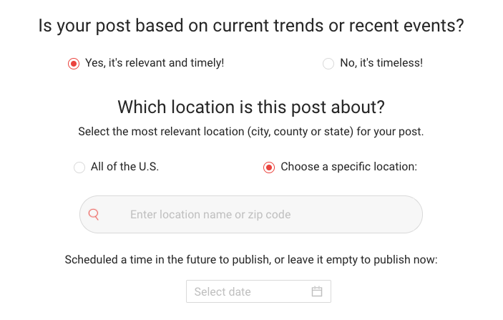
Distribution Channel
Combined Influence
human judgement + algorithmic decision
Human labeling options
Timely v.s. Timeless
National v.s. Local
Publish Now v.s. Publish Later
Recommendation algorithm
Corresponding verification classifiers
Corresponding retrieval & ranking strategies

Slide 19
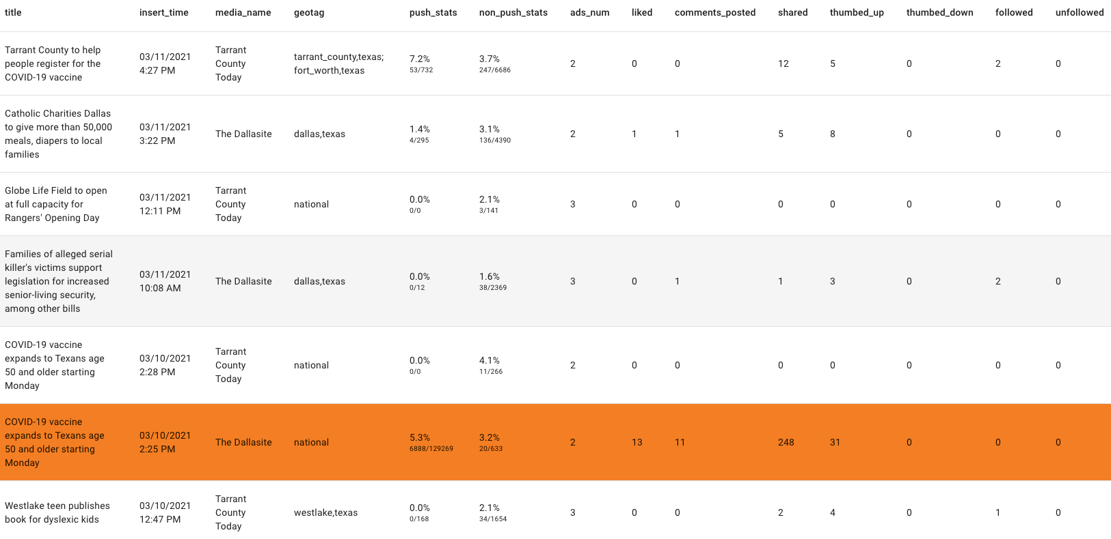
Feedback Loop
From Dev Team to Local Journalists
Data Tracking
Engagement report
Content value scores
From Local Journalist to Dev Team
Detailed Request on Tooling Improvement
Schedule to publish
Image automatic credit line

Slide 20
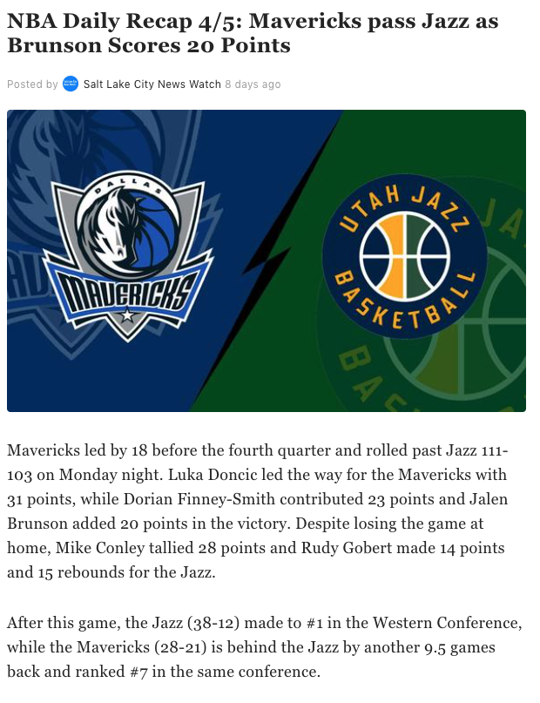
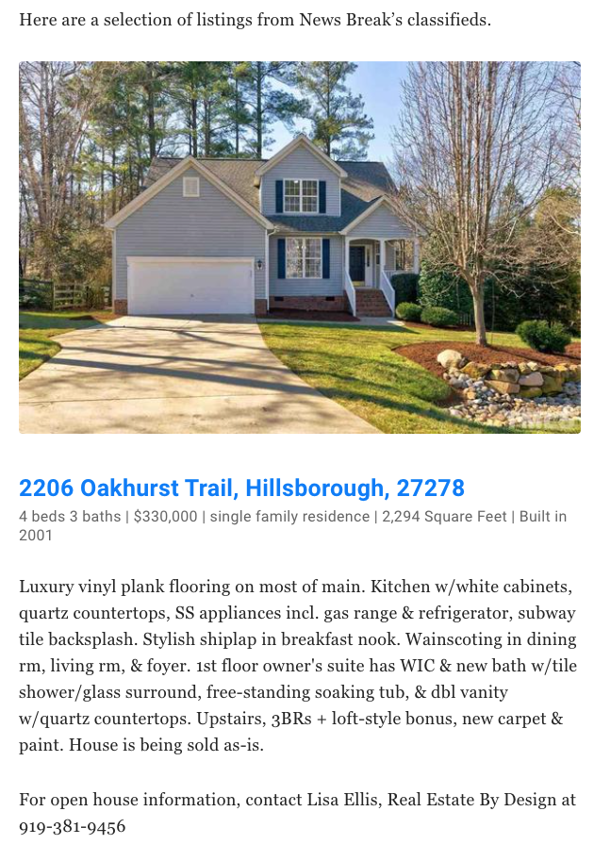
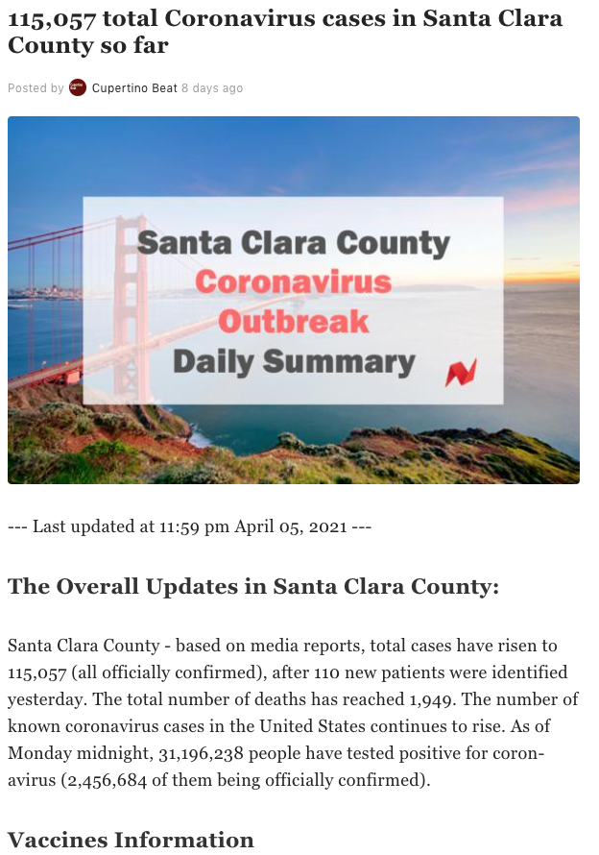
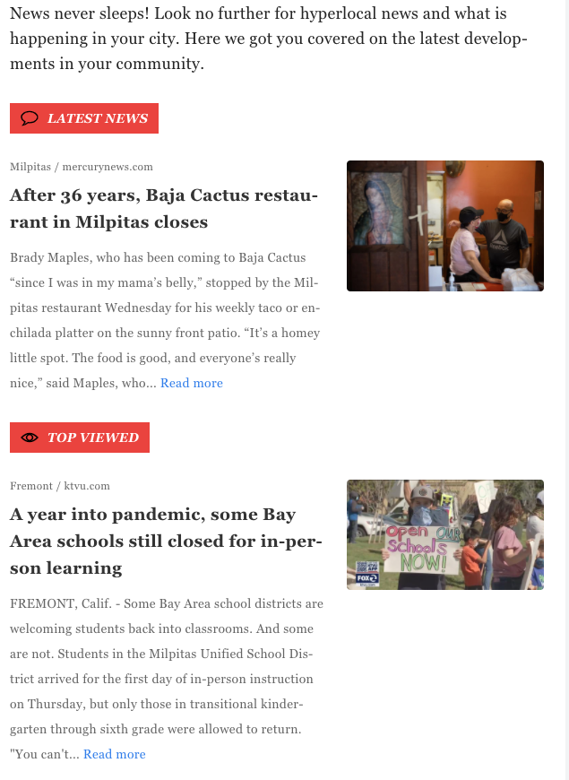
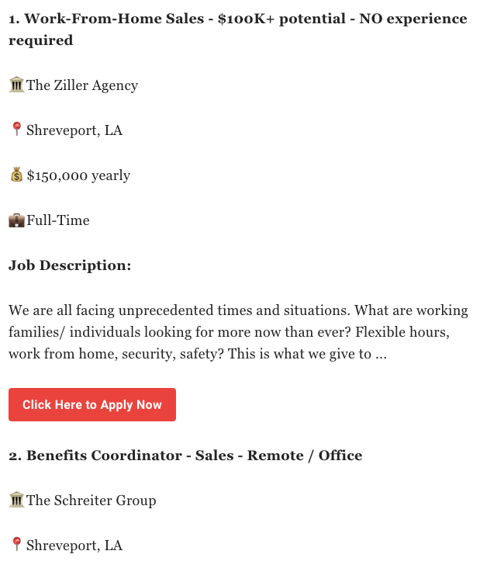
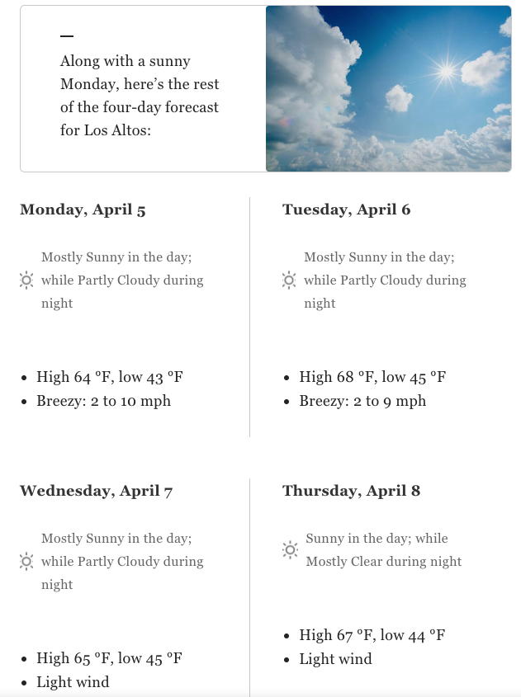
Template Based Content Augmentation
Turn structured data into articles
Local Journalist curate various templates
Supported Article Topics
Local Weather
Local Job
Local Digest
Real Estate
Local Sport

Slide 21
Conclusions and Open Problems

Slide 22
Key Takeaway
Revitalizing local journalism is an important yet challenging task
We believe AI-assisted writing could address many of the pain points for local journalists
We believe a human-in-the-loop approach is necessary to ensure content quality

Slide 23
Open Problems
How to accurately measure the effect of AI-assisted writing tools?
How to inspire local journalists during the creative process?
How can editorial judgement help with the distribution of news in the recommendation algorithm?
...

Slide 24


More info ...
News Break Homepage: https://www.newsbreak.com/
News Break Creator Program: https://creators.newsbreak.com/creators
News Break Email Newsletter Subscription Page: https://newsletter.newsbreakapp.com
We are hiring! Check out our career page: https://www.newsbreak.com/careers
Download News Break App via ios android

Slide 25


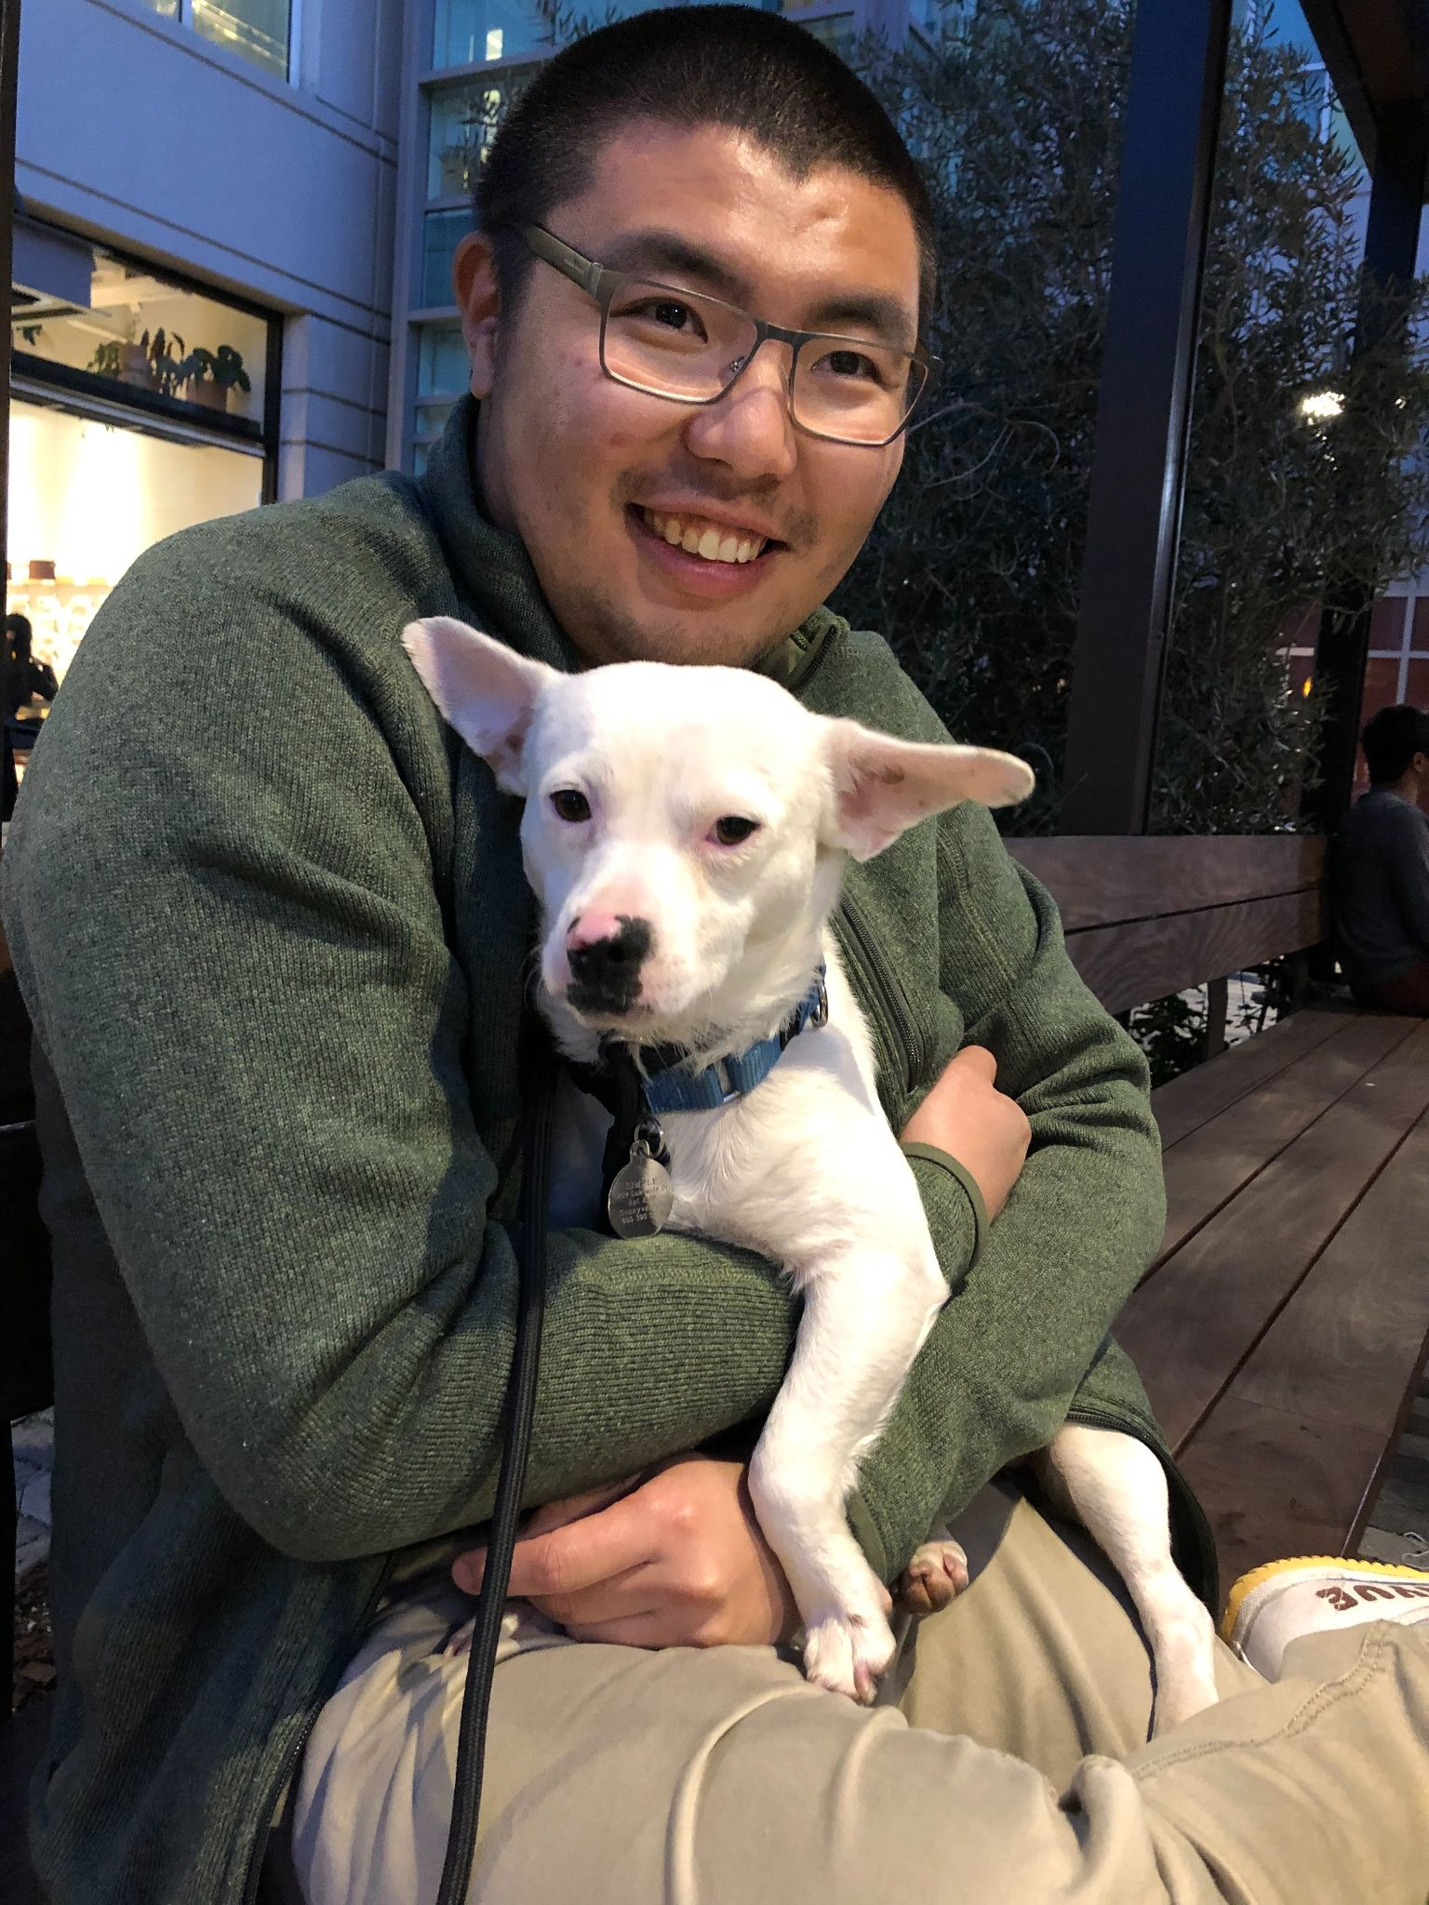
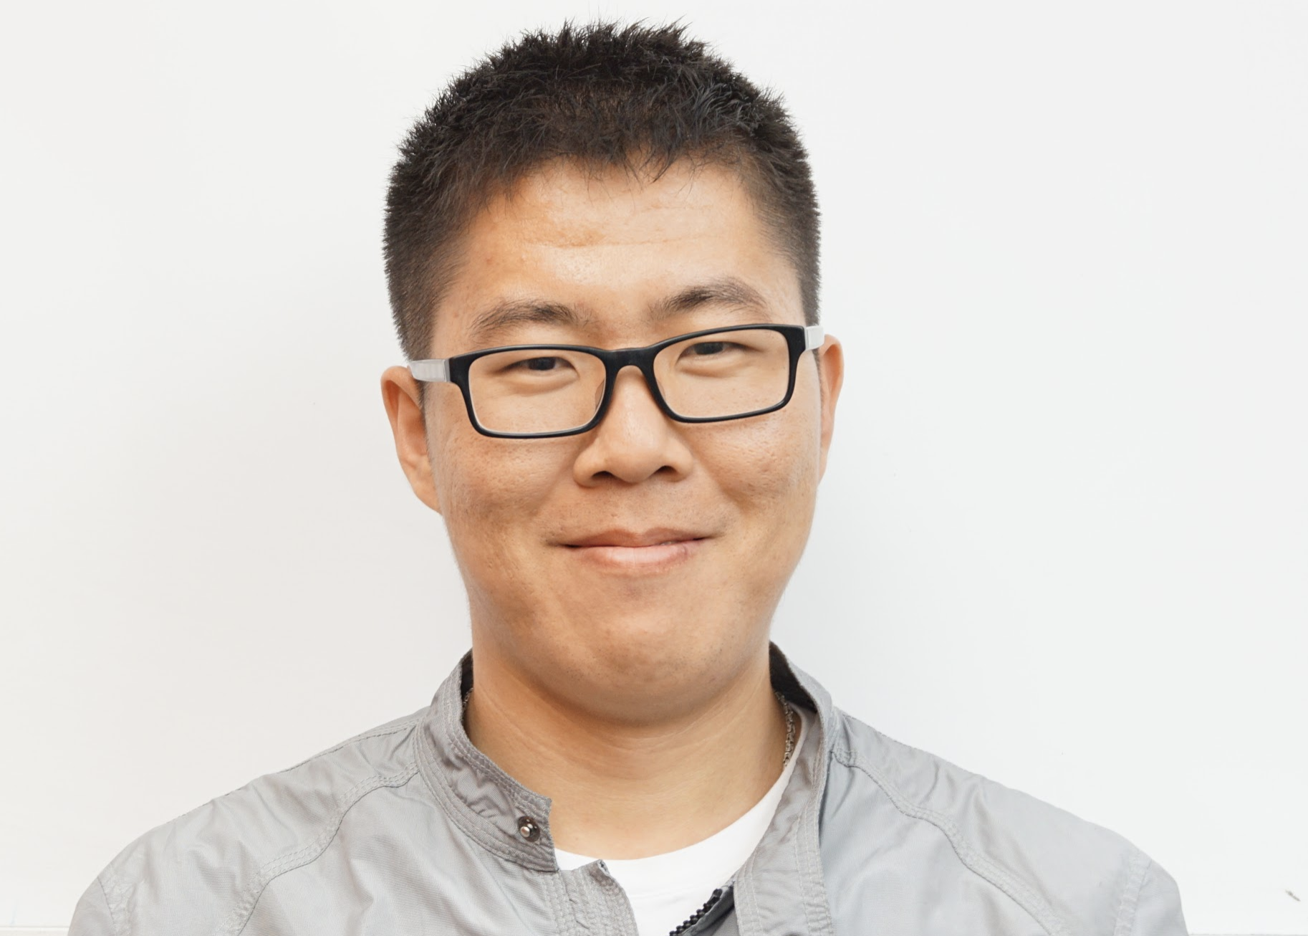
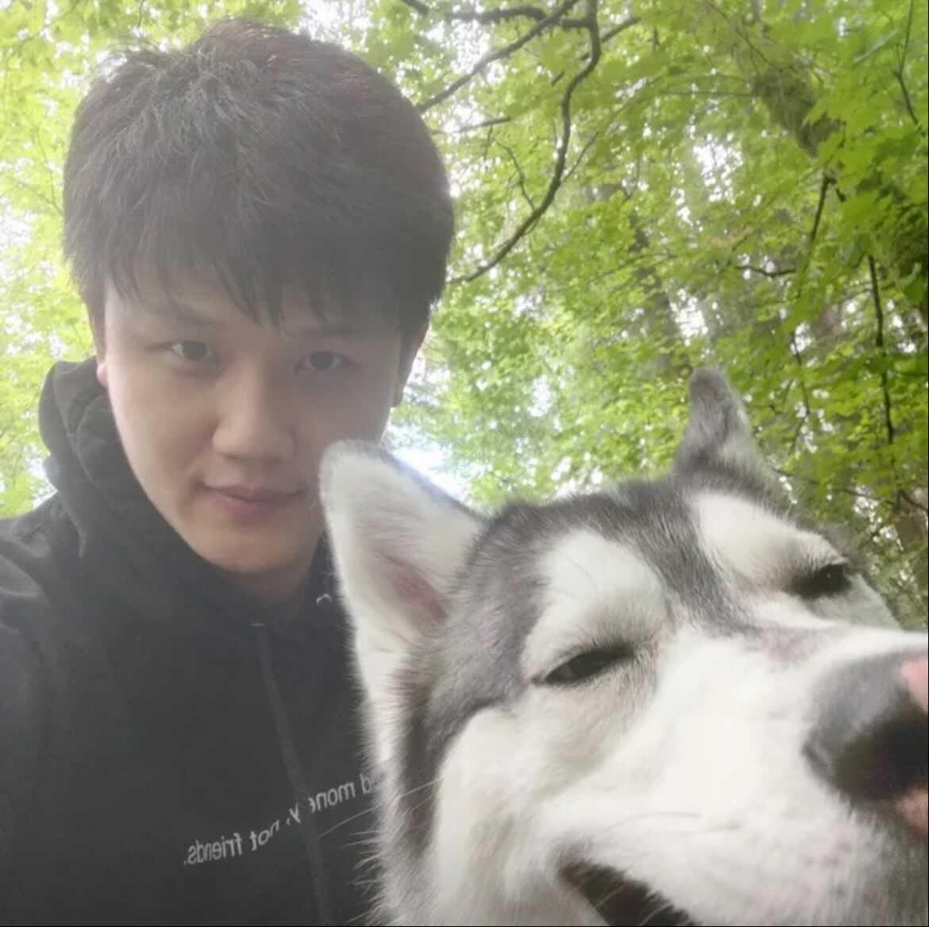
Thank You !
Acknowledgement
Collaborators: Cognitive Science & Design Lab, UCSD
Team at News Break:
William Zhang Dominic Delgado Silu Yang Dr. Wei Fu Dr. Xiaolin Li

